Slide 1

Principles of Web Design 6th Edition
Chapter 4 – Cascading Style Sheets

Slide 2
Objectives
Recognize the benefits of using CSS
Build a basic style sheet
Use inheritance to write simpler style rules
Examine basic selection techniques
Apply basic selection techniques
Use class and id selectors
Use the <div> and <span> elements
Use other selectors

Slide 3
The Evolution of CSS
CSS was developed to standardize display information
CSS was slow to be supported by browsers
Newer browsers offer more complete support
Latest release is CSS3

Slide 4
CSS Style Rules
In CSS, style rules express the style characteristics for an HTML element
A set of style rules is called a style sheet
Style rules are easy to write and interpret

Slide 5
CSS Style Rules
Style rules are composed of two parts: a selector and a declaration
The selector determines the element to which the rule is applied
The declaration details the exact property values

Slide 6
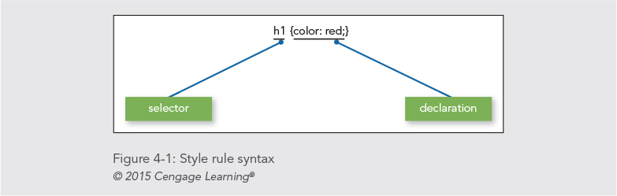
CSS Style Rules

Slide 7
CSS Style Rules
The declaration contains a property and a value
The property is a quality or characteristic
The precise specification of the property is contained in the value
CSS includes a wide variety of different properties, each with a specific number of values

Slide 8
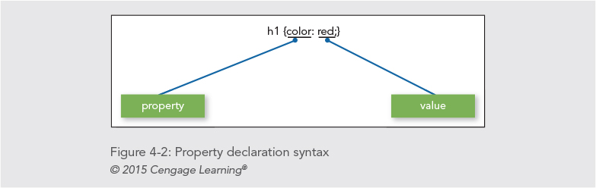
CSS Style Rules

Slide 9
Combining CSS Style Rules with HTML
You combine CSS with HTML in three ways:
Inline style
Internal style sheet
External style sheet

Slide 10
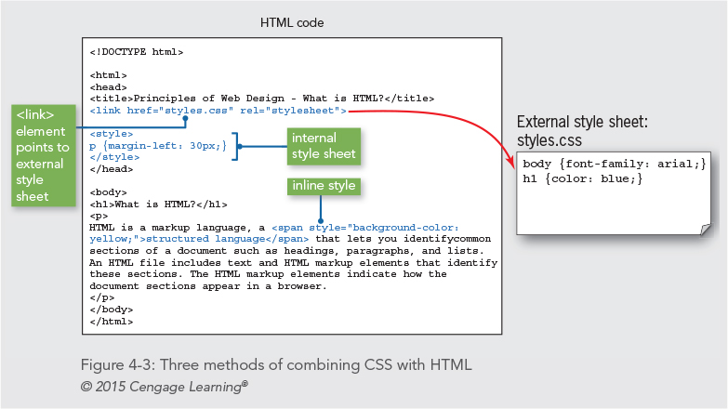

Slide 11
Using External Style Sheets
External style sheets let you specify rules for multiple web pages
These are text documents that contain style rules
External style sheets have a .css extension

Slide 12
Linking to an External Style Sheet
The link element lets you specify an external style sheet
It is used within the <head> section of a document
<head>
<title>Sample Document</title>
<link href="styles.css" rel="stylesheet" type="text/css">
</head>

Slide 13
Using Internal Style Sheets
Internal style sheets are contained within the <style> element
The style element is contained within the <head> section of the document
Style rules contained in an internal style sheet only affect the document in which they reside
<head>
<title>Sample Document</title>
<style>
h1 {color: red;}
</style>
</head>

Slide 14
Using Inline Styles
You can define styles for a single element with the style attribute
The style attribute can be used to override a style that was set at a higher level
The style attribute is useful for testing styles during development
This is the least used method of applying CSS styles
<h1 style="color: blue">Some Text</h1>

Slide 15
Writing Clean CSS Code
Write CSS code that is consistent and easy to read
Correct but hard-to-read:
p {font-family: arial, helvetica, sans-serif; font-size: 85%; line-height: 110%; margin-left: 30px;}
Better:
p {
font-family: arial, helvetica, sans-serif;
font-size: 85%;
line-height: 110%;
margin-left: 30px;
}
Use comments in your code

Slide 16
Using Inheritance to Write Simpler Style Rules
Elements in an HTML document are structured in a hierarchy
Parent elements contain child elements
Elements can be both parent and child elements
The CSS properties inherit from parent to child
The property descriptions list whether a property is inherited
You can style multiple document elements with just a few style rules using inheritance

Slide 17
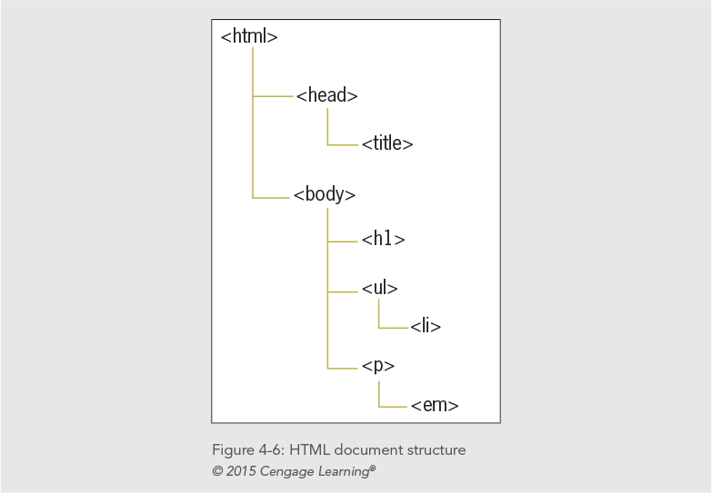

Slide 18
Using Inheritance to Write Simpler Style Rules
Specific style rules:
<style>
h1 {color: red;}
p {color: red;}
ul {color: red;}
em {color: red;}
li {color: red;}
</style>
Using inheritance:
<style>
body {color: red;}
</style>

Slide 19
Examining Basic Selection Techniques
In this section, you will review style rule syntax and learn about the following basic selection techniques:
Using type selectors
Grouping selectors
Combining declarations
Using descendant selectors

Slide 20
Using Type Selectors
The selector determines the element to which a style declaration is applied
Type selectors are the simplest form of selector
They select every element in the document that matches the style rule
In the following example, all h1 elements are red

Slide 21
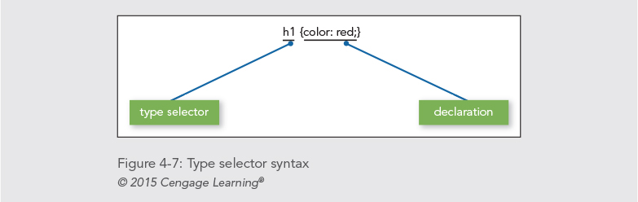
Using Type Selectors

Slide 22
Grouping Selectors
You can group selectors to which the same rules apply
Specific style rules:
h1 {color: red;}
h2 {color: red;}
Grouping selectors:
h1, h2 {color: red;}

Slide 23
Combining Declarations
You can state multiple property declarations for the same selector
Specific style rules:
p {color: blue;}
p {font-size: 125%;}
Combining declarations:
p {
color: blue;
font-size: 125%;
}

Slide 24
Using Descendant Selectors
You can select elements that are descendents of other elements
Selecting only <em> elements that are contained within <p> elements
p em {color: blue;}

Slide 25
Using the Universal Selector
Universal selector lets you select groups of elements
Selecting all children of the dead element:
div * {font-family: sans-serif;}

Slide 26
Using class and id Selectors
You will learn to select elements of an HTML document using the following methods:
The class selector
The id selector
The <div> and <span> elements
The pseudo-class and pseudo-element selectors

Slide 27
Using the class Selector
The class selector lets you write rules and give them a name
You can apply that name to any element you choose
The class attribute lets you apply the style rule name to an element
The period (.) flag character indicates the selector is a class selector

Slide 28
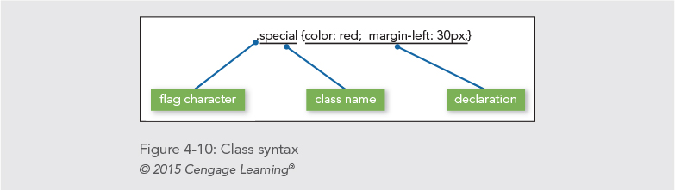
Using the Class Selector

Slide 29
Using the Class Selector
Style rule:
.intro {font-size: 125%;}
Applied in document:
<p class="intro">This is the first paragraph of thedocument. It has a different style based on the "intro”class selector.</p>

Slide 30
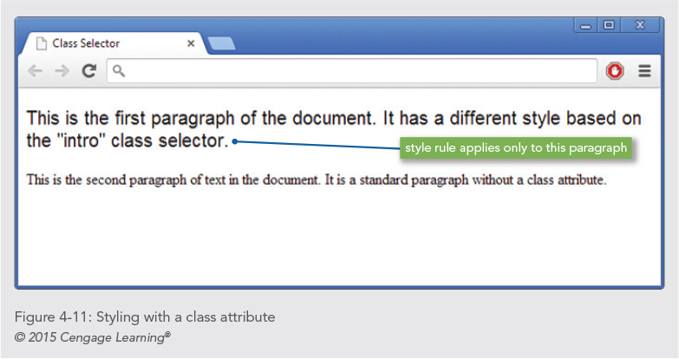

Slide 31
Using the id Selector
The difference between id and class is that id refers to only one instance of the id attribute value within a document
The ID attribute is used to identify layout sections of the page
The ID attribute uses a pound sign (#) flag character

Slide 32
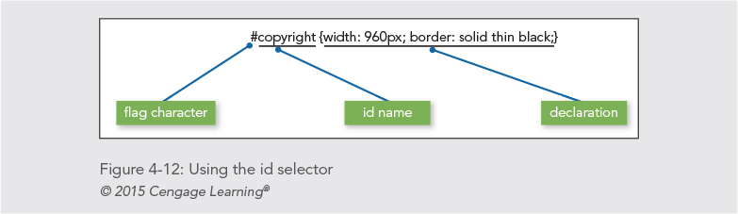
Using the id Selector

Slide 33
Using the id Selector
Applied in document:
<p id="copyright">This is the copyright information for the page.</p>

Slide 34
Using the <div> and <span> Elements
The <div> (division) and <span> (span of words) elements are designed to be used with CSS
They let you specify logical divisions within a document that have their own name and style properties

Slide 35
Working with <div> elements
Use <div> with the class and ID attributes to create logical divisions on a web page
A division with an id named column as the selector:
div#column {
width: 200px;
height: auto;
padding: 15px;
border: thin solid;
}
Applied in the document:
<div id="column">This division displays… </div>

Slide 36
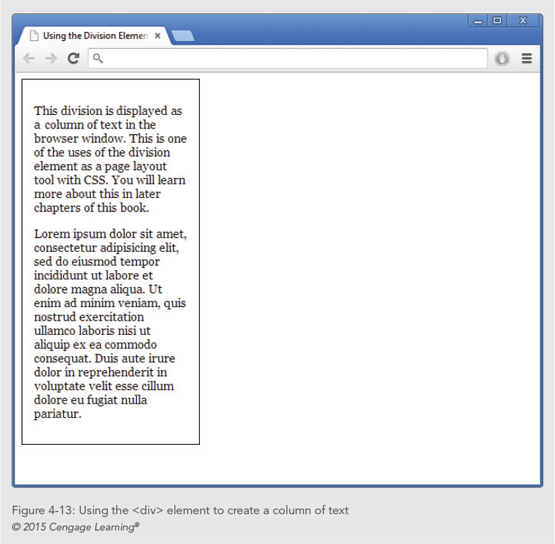
Try it yourself: http://www.w3schools.com/code/tryit.asp?filename=FBQ1MES32VSI

Slide 37
Working with <span> elements
The span element lets you specify in-line elements that have their own name and style properties
In-line elements reside within a line of text

Slide 38
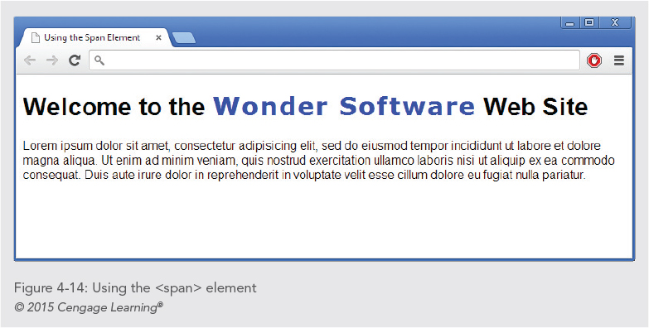

Slide 39
Working with <span> elements
Style rule:
span.logo {
color: white;
background-color: black;
}
Applied in document:
<p>Welcome to the <span class="logo">Wonder Software</span>Web site.</p>
http://www.w3schools.com/code/tryit.asp?filename=FBQZ7L8X3P61

Slide 40
Using Attribute Selectors
Attribute selectors let you select an element based on whether the element contains an attribute
Elements can be selected based on a specific value the attribute contains

Slide 41
Using Attribute Selectors
Attribute selectors match against attributes and their values
To select this element:
<img src="images/home.gif" title="home" alt="Home navigation button" />
using attribute selectors, you could use the value that the title attribute contains, as shown:
img[title=home] {border-color: red;}

Slide 42
Using Pseudo-Class and Pseudo-Element Selectors
Pseudo-classes select elements based on characteristics other than their element name
For example, you can change the characteristics of hypertext links with pseudo-classes
Pseudo-elements let you change other aspects of a document that are not classified by standard elements such as the first letter or line of a paragraph

Slide 43
Using the Link Pseudo-Classes
The link pseudo-classes let you change the style characteristics for four different hypertext link states
These pseudo-classes only apply to the <a> element with an href attribute

Slide 44
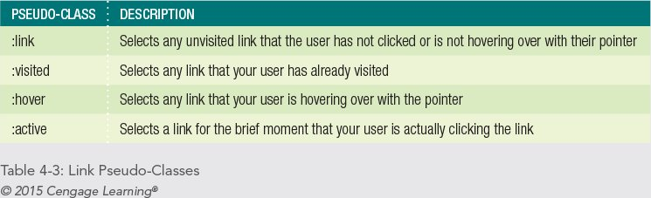
Using the Link Pseudo-Classes

Slide 45
Using the Link Pseudo-Classes
Because of the specificity of the pseudo-class selectors, you should always place your link pseudo-class in the following order:
1. Link
2. Visited
3. Hover
4. Active

Slide 46
Using the Link Pseudo-Classes
The following rules change the colors of the hypertext links:
:link {color: red;}
:visited {color: green;}

Slide 47
Using the :hover Pseudo-Class
The :hover pseudo-class lets you apply a style that appears when the user points to an element with a pointing device
a:hover {background-color: yellow;}

Slide 48
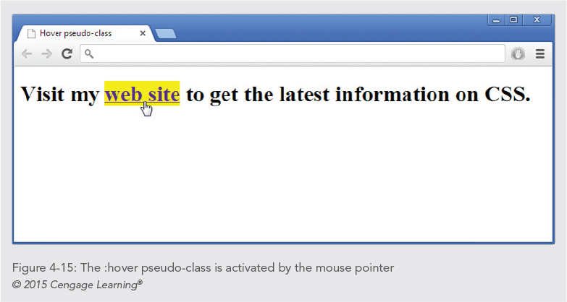

Slide 49
Using the :first-letter Pseudo-Element
Use the :first-letter pseudo-element to apply style rules to the first letter of any element:
p:first-letter {
font-weight: bold;
font-size: 200%;
}
http://www.w3schools.com/code/tryit.asp?filename=FBQ213GS2BK3

Slide 50
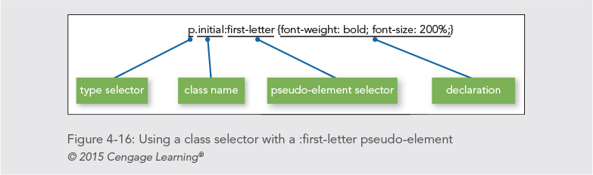
Using the :first-letter Pseudo-Element

Slide 51
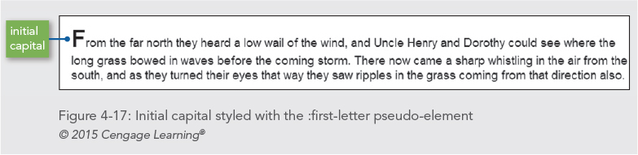
Using the :first-letter Pseudo-Element

Slide 52
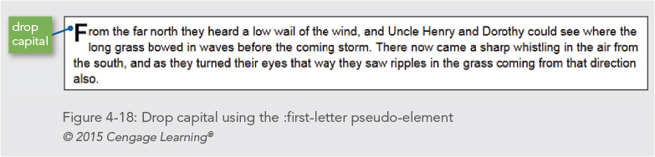
Using the :first-letter Pseudo-Element

Slide 53
Using the :first-line Pseudo-Element
The :first-line pseudo-element works in much the same way as :first-letter
It affects the first line of text in an element:
p:first-line {text-transform: uppercase;}
http://www.w3schools.com/code/tryit.asp?filename=FBQ24G12JT7C

Slide 54
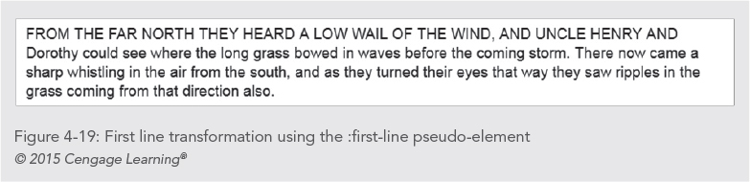
Using the :first-line Pseudo-Element

Slide 55
Using the :before and :after Pseudo-Elements
These psuedo-elements let you insert created content
These are useful for repeated content
For example, the following style rule inserts the word Figure followed by a colon before an <P> text that has the flass figtitle:
p.figtitle:before {content: “Figure: “;}

Slide 56
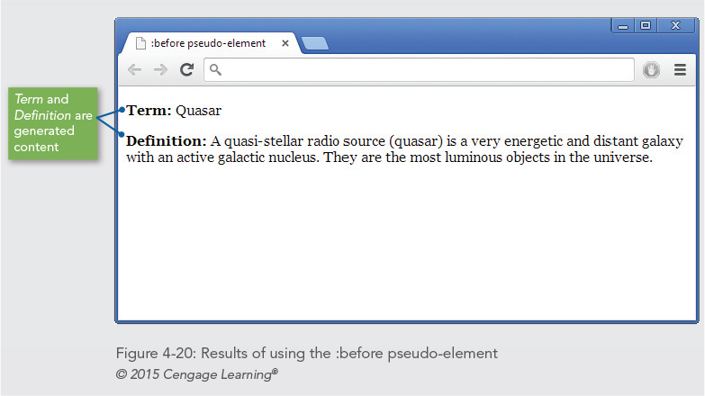

Slide 57
Understanding How the Cascade Affects Style Rules
The cascade means that multiple style sheets and style rules can apply to the same document
Only one rule can apply to an element
The CSS cascading mechanism determines which rules apply based on three variables:
Specificity of the selector
Order of the rule in the style sheet
Use of the !important keyword

Slide 58
Determining Rule Weight by Specificity
If we have:
p {color: red;}
div p {color: blue;}
The first applies to all <p> elements on the page.
the second applies to <p> elements that are specifically within a <div> element in the page.
check it out please:
http://www.w3schools.com/code/tryit.asp?filename=FBPUL69TIZAB

Slide 59
Determining Rule Weight by Order
Rules that are included later in the style sheet order take precedence over earlier rules.
Check it out:
http://www.w3schools.com/code/tryit.asp?filename=FBPUQE50VG8Y

Slide 60
Determining Rule Weight with the !important Keyword
The !important specifies that a rule should take precedence no matter what order the rules in the style sheet.
Check it out:
http://www.w3schools.com/code/tryit.asp?filename=FBPUVOS7HF2Z

Slide 61
Summary
CSS rules can be combined with the HTML code in a number of ways
CSS is easy to read and write
CSS uses inheritance and cascading to determine which style rules take precedence
You can combine selectors and declarations in multiple ways
There are many ways to select elements

Slide 62
Summary
Class and ID attribute selectors are often paired with <div> and <span> elements to create layout elements
The pseudo-class and pseudo-element selectors let you change color and styling of links and other elements of a document

